Slide 1
5 Discrete Probability Distributions
Business Statistics:
Communicating with Numbers, 4e
By Sanjiv Jaggia and Alison Kelly
Copyright 2022 © McGraw Hill LLC. All rights reserved. No reproduction or distribution without the prior written consent of McGraw Hill LLC.

Slide 2
Chapter 5 Learning Objectives (L Os)
L O 5.1 Describe a discrete random variable and its probability distribution.
L O 5.2 Calculate and interpret summary measures for a discrete random variable.
L O 5.3 Calculate and interpret summary measures to evaluate portfolio returns.
L O 5.4 Calculate and interpret probabilities for a binomial random variable.
L O 5.5 Calculate and interpret probabilities for a Poisson random variable.
L O 5.6 Calculate and interpret probabilities for a hypergeometric random variable.

Slide 3
Introductory Case: Available Staff for Probable Customers
Anne Jones is a manager of a local Starbucks.
Starbucks announced plans in 2008 to close 500 U.S. locations.
While Anne’s store will remain open, she is concerned that nearby closings might affect her business.
Anne needs to decide staffing needs.
Too many employees would be costly to the store.
Not enough employees could result in losing customers who choose not to wait.
With an understanding of the probability distribution of customer arrivals, Anne will be able to:
Calculate the expected number of visits from a typical Starbucks customer in a given time period.
Calculate the probability that a typical customer visits the store a specific number of times in a given time period.

Slide 4
5.1 Random Variables and Discrete Probability Distributions 1
A random variable is a function that assigns numerical values to the outcomes of an experiment.
Captures uncertainty.
Summarizes outcomes of an experiment with numerical values.
A discrete random variable assumes a countable number of distinct values.
Use the letter X to denote a random variable.
Distinct values are represented by
Example: number of employees.
A continuous random variable is characterized by an uncountable values in an interval.
Cannot summarize with a list.
Example: return on a mutual fund.

Slide 5
5.1 Random Variables and Discrete Probability Distributions 2
Every discrete random variable is associated with a probability distribution.
Called a probability mass function.
Provides the probability that a random variable assumes a particular value,
Two key properties,
The probability of each value of x is a value between 0 and 1,
The sum of the probabilities equals 1, or
A discrete random variable can also be defined in terms of the cumulative
distribution function,

Slide 6
5.1 Random Variables and Discrete Probability Distributions 3
View the probability distribution in several ways.
Example: number rolled on a die, a discrete uniform.
Finite number of values.
Each value is equally likely.
Symmetric.

Slide 7
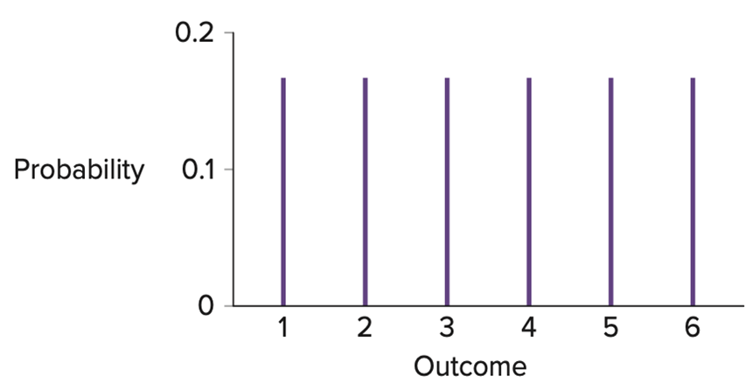
5.1 Random Variables and Discrete Probability Distributions 4
Example continued,

Slide 8
5.1 Random Variables and Discrete Probability Distributions 5
Example: the number of houses a realtor sells in a month.
Number of Houses Sold | Probability
0 | 0.30
1 | 0.50
2 | 0.15
3 | 0.05
a. Is this a valid probability distribution?
b. What is the probability that the realtor does not sell any houses?
c. What is the probability that the realtor sells at most one house?
d. What is the probability that the realtor sells at least two houses?
e. Graphically depict the probability distribution.

Slide 9
5.1 Random Variables and Discrete Probability Distributions 6
Example continued,
a. Yes, because
b.
c.
d.
Alternatively,

Slide 10
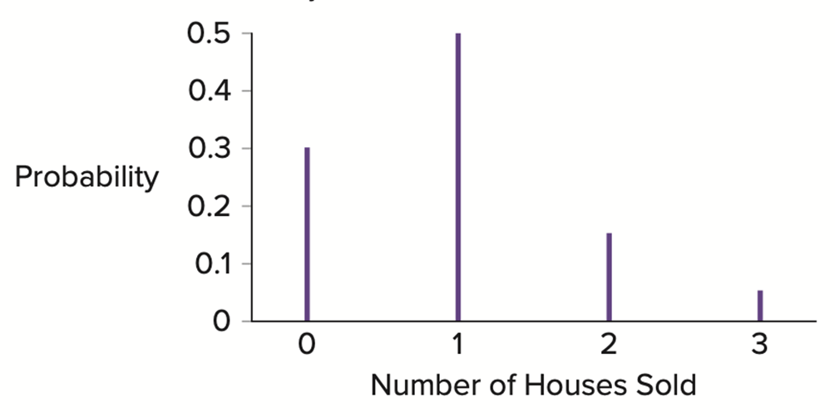
5.1 Random Variables and Discrete Probability Distributions 7
Example continued,
e.
Access the text alternative for slide images.

Slide 11
5.2 Expected Value, Variance, and Standard Deviation 1
The expected value is also referred to as the mean.
It is a weighted average of all possible values of X.
Denoted as
indicates central location.
It is calculated as
The variance and standard deviation are both measures of variability.
The variance is denoted
The variance is calculated as
The standard deviation is denoted by
Indicates if values are clustered about the mean or widely scattered.

Slide 12
5.2 Expected Value, Variance, and Standard Deviation 2
Example: Brad Williams is the owner of a large car dealership in Chicago. Brad decides to construct an incentive compensation program that equitably and consistently compensates employees on the basis of their performance.
Bonus (in $1,000s) | Performance Type | Probability
10 | Superior | 0.15
6 | Good | 0.25
3 | Fair | 0.40
0 | Poor | 0.20
a. Calculate the expected value of the annual bonus amount.
b. Calculate the variance and the standard deviation of the annual bonus amount.
c. What is the total annual amount that Brad can expect to pay in bonuses if he has 25 employees?

Slide 13
5.2 Expected Value, Variance, and Standard Deviation 3
Let the random variable X denote the bonus amount (in $1,000’s).
a. The expected value is
b. The variance is
the standard deviation is
c. If Brad has 25 employees, we can expect to pay $4,200 × 25 = $105,000 in bonuses.

Slide 14
5.2 Expected Value, Variance, and Standard Deviation 4
Risk-averse consumers.
Demand positive expected gain as compensation for taking risk.
May decline a risky prospect even if it offers a positive expected gain.
Risk-neutral consumers.
Completely ignore risk.
Always accept a prospect that offers a positive expected gain.
Risk-loving consumers.
May accept a risky prospect even if the expected gain is negative.

Slide 15
5.2 Expected Value, Variance, and Standard Deviation 5
Example: Suppose you have a choice of receiving $1,000 in cash or receiving a beautiful painting from your grandmother.
The actual value of the painting is uncertain.
What should you do?
x | P(X = x)
2,000 | 0.20
1,000 | 0.50
500 | 0.30
The expected value is $1,050.
Expected value > $1,000 it may seem logical to choose the painting.
But a risk-averse person might not agree.

Slide 16
5.3 Portfolio Returns 1
Investment opportunities often use:
Expected return as a measure of reward.
Variance or standard deviation of return as a measure of risk.
A portfolio is defined as a collection of assets such as stocks and bonds.
The expected return and variance of a portfolio depend on the joint distribution of random variables.
Let X and Y be random variables for the returns of two assets (stocks and bonds).
If an investor has invested in both, the return generated by the portfolio is a linear combination X+Y.

Slide 17
5.3 Portfolio Returns 2
Let X and Y be random variables.
E(X + Y) = E(X) + E(Y)
Var(X + Y) = Var(X) + Var(Y) + 2Cov(X, Y) where Cov is the covariance between X and Y.
Let a and b be constants.
Use these results to derive the expected return and variance for a portfolio.

Slide 18
5.3 Portfolio Returns 3
Let R_{P} be the random variable for the return of the portfolio with assets A and B.
Let R_{A} and R_{B} be random variables for the returns of assets A and B with weights w_{A} and w_{B} where w_{A} + w_{B} = 1.
Expected return of the portfolio is
Variance of the portfolio is,
The standard deviation
is the positive square root of the variance.
The risk of the portfolio depends on the risk of the assets but he interplay between them.
For example, if one asset does poorly, the second may serve as an offsetting factor.
The correlation is easier to interpret.

Slide 19
5.3 Portfolio Returns 4
Example: consider an investment portfolio of $40,000 in stock A and $60,000 in stock B.
a. Calculate the expected return of the portfolio.
b. Calculate the correlation between the returns.
c. Calculate the variance and standard deviation of the portfolio.

Slide 20
5.3 Portfolio Returns 5
Example continued,
a.
b.
the returns have a weak positive linear
relationship.
c.
the standard deviation is 7.74%.

Slide 21
5.4 The Binomial Distribution 1
Different types of experiments generate different probability distributions.
Binomial.
Poisson.
Hypergeometric.
A Bernoulli process consists of a series of n independent and identical trials of an experiment such that on each trial:
There are only two possible outcomes: success and failure.
The probabilities of success and failure remain the same from trial to trial.
Use p to denote the probability of success, and 1 − p is the probability of failure.

Slide 22
5.4 The Binomial Distribution 2
A binomial random variable X is defined as the number of successes achieved in the n trials of a Bernoulli process.
The possible values are
The binomial distribution or binomial probability distribution shows the probabilities associated with the possible values.
Examples:
A customer defaults or does not default on a loan.
A consumer reacts positively or negatively to a social media campaign.
A drug is either effective or ineffective.
Before arriving at a general formula for the distribution, we construct a probability tree to illustrate the outcomes and probabilities.

Slide 23
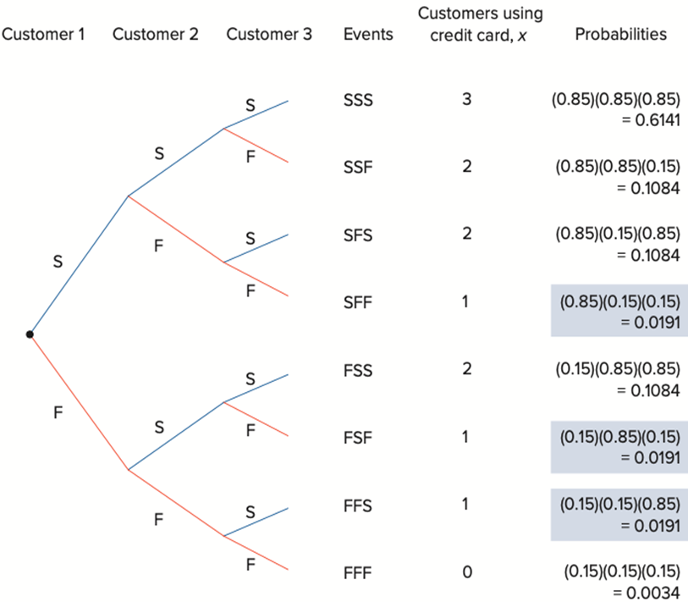
5.4 The Binomial Distribution 3
Example: 85% of customers will use a credit card.
x | P(X = x)
0 | 0.0034
1 | 0.0573
2 | 0.3252
3 | 0.6141
 | Total = 1
Access the text alternative for slide images.

Slide 24
5.4 The Binomial Distribution 4
For a binomial random variable X, the probability of x successes in n Bernoulli trials is
This is for
By definition,
There are two parts of the formula.
The first term,
tells us how many sequences with x successes
and n − x failures are possible in n trials.
The second part of the equation,
represents the probability of any
particular sequence with x successes and n − x failures.

Slide 25
5.4 The Binomial Distribution 5
The mean is
The variance is

Slide 26
5.4 The Binomial Distribution 6
Example: in the United States, about 30% of adults have four-year college degrees. Suppose five adults are randomly selected.
a. What is the probability that none of the adults have a college degree?
b. What is the probability that no more than two of the adults have a college degree?
c. What is the probability that at least two of the adults have a college degree?
d. Calculate the expected value, variance and the standard deviation of the distribution.
e. Graphically depict the distribution.

Slide 27
5.4 The Binomial Distribution 7
Example continued,
This problem is a Bernoulli process with n = 5 adults.
Either an adult has a college degree, or they do not.
Probability p = 0.30.
a.
b.
c.

Slide 28
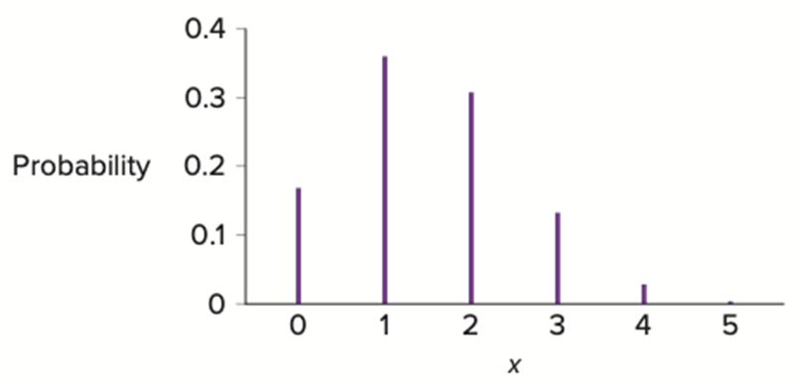
5.4 The Binomial Distribution 8
Example continued,
d. Mean:
Variance is
Standard deviation
e.
x | P(X = x)
0 | 0.1681
1 | 0.3602
2 | 0.3087
3 | 0.1323
4 | 0.0284
5 | 0.0024
Access the text alternative for slide images.

Slide 29
5.4 The Binomial Distribution 9
Excel and R functionality.
Distribution | Excel | R
Binomial
P(X = x): | =BINOM.DIST (x, n, p, 0) | dbinom(x, n, p)
P(X ≤ x): | =BINOM.DIST(x, n, p, 1) | pbinom(x, n, p)
Poisson
P(X = x): | =POISSON.DIST (x, μ, 0) | dpois (x, μ)
P(X ≤ x): | =POISSON.DIST (x, μ, 1) | ppois (x, μ)
Hypergeometric
P(X = x): | =HYPGEOM.DIST(x, n, S, N, 0) | dhyper(x, S, N − S, n)
P(X ≤ x): | =HYPGEOM.DIST(x, n, S, N, 1) | phyper(x, S, N − S, n)

Slide 30
5.5 The Poisson Distribution 1
An experiment satisfies a Poisson process if:
The number of successes with a specified time or space interval equals any integer between zero and infinity.
The number of successes counted in nonoverlapping intervals are independent.
The probability of success in any interval is the same for all intervals of equal size and is proportional to the size of the interval.
Examples:
The number of customers who use a new banking app in a day.
The number of spam emails received in a month.
The number of defects in a 50-yard roll of fabric.
A Poisson random variable is the number of successes achieved in a specified time or space interval.

Slide 31
5.5 The Poisson Distribution 2
For a Poisson random variable X, the probability of x successes over a given
interval of time or space is
This is for
is the mean number of successes.
is the base of the natural logarithm.
The mean is
The variance is

Slide 32
5.5 The Poisson Distribution 3
Example: Anne is concerned about staffing needs at the Starbucks that she manages. She believes that the typical Starbucks customer averages 18 visits to the store over a 30-day month.
a. How many visits should Anne expect in a 5-day period from a typical Starbucks customer?
b. What is the probability that a customer visits the chain five times in a 5-day period?
c. What is the probability that a customer visits the chain no more than two times in a 5-day period?
d. What is the probability that a customer visits the at least three times in a 5-day period?

Slide 33
5.5 The Poisson Distribution 4
Example continued,
a. Given the rate of 18 visits over a 30-day month, the mean for the 30-day period as
So the mean for the 5-day period is
b.
c.
d.
Cannot be found since there is an infinite number of possibilities.

Slide 34
5.5 The Poisson Distribution 5
Excel and R functionality.
Distribution | Excel | R
Binomial
P(X = x): | =BINOM.DIST (x, n, p, 0) | dbinom(x, n, p)
P(X ≤ x): | =BINOM.DIST(x, n, p, 1) | pbinom(x, n, p)
Poisson
P(X = x): | =POISSON.DIST (x, μ, 0) | dpois (x, μ)
P(X ≤ x): | =POISSON.DIST (x, μ, 1) | ppois (x, μ)
Hypergeometric
P(X = x): | =HYPGEOM.DIST(x, n, S, N, 0) | dhyper(x, S, N − S, n)
P(X ≤ x): | =HYPGEOM.DIST(x, n, S, N, 1) | phyper(x, S, N − S, n)

Slide 35
5.6 The Hypergeometric Distribution 1
The binomial distribution is appropriate when you sample with replacement.
The probability of success does not change from trial to trial.
The trials are independent.
Sampling without replacement: after an item is drawn, it is not put back for subsequent draws.
Trials not independent.
The probability of success changes from trial to trial.
Use the hypergeometric distribution in place of the binomial distribution when sampling without replacement.
The number of successes in a two outcome experiment.
Trials are not independent of one another.

Slide 36
5.6 The Hypergeometric Distribution 2
The probability of x successes in a random selection of n items is,
N is the population size, S is the number of population successes, n is the sample size.
For

Slide 37
5.6 The Hypergeometric Distribution 3
The formula consists of three parts,
the number of ways to select x success from S population successes.
the number of ways to select
population failures.
the number of ways a sample of size n can be selected from a
population of size N.

Slide 38
5.6 The Hypergeometric Distribution 4
Example: inspect five mangoes from a box containing 20 mangos with exactly two damaged mangos.
What is the probability that one out of the five mangoes is damaged?
If the manager decides to reject the shipment if one or more of the mangoes are damaged, what is the probability that the shipment will be rejected?

Slide 39
5.6 The Hypergeometric Distribution 5
Calculate the expected value, the variance, and the standard deviation.

Slide 40
5.6 The Hypergeometric Distribution 6
Excel and R functionality.
Distribution | Excel | R
Binomial
P(X = x): | =BINOM.DIST (x, n, p, 0) | dbinom(x, n, p)
P(X ≤ x): | =BINOM.DIST(x, n, p, 1) | pbinom(x, n, p)
Poisson
P(X = x): | =POISSON.DIST (x, μ, 0) | dpois (x, μ)
P(X ≤ x): | =POISSON.DIST (x, μ, 1) | ppois (x, μ)
Hypergeometric
P(X = x): | =HYPGEOM.DIST(x, n, S, N, 0) | dhyper(x, S, N − S, n)
P(X ≤ x): | =HYPGEOM.DIST(x, n, S, N, 1) | phyper(x, S, N − S, n)

Slide 41
End of Main Content
Copyright 2022 © McGraw Hill LLC. All rights reserved. No reproduction or distribution without the prior written consent of McGraw Hill LLC.

Slide 42
Accessibility Content: Text Alternatives for Images

Slide 43
5.1 Random Variables and Discrete Probability Distributions 7 – Text Alternative
Return to parent-slide containing images.
0 homes has a probability of 0.3. 1 home has a probability of 0.5. 2 homes has a probability of 0.15. 3 homes has a probability of 0.05.
Return to parent-slide containing images.

Slide 44
5.4 The Binomial Distribution 3 – Text Alternative
Return to parent-slide containing images.
Node 1 is under customer 1. Nodes 2 and 3 are under customer 2. Nodes 4, 5, 6, and 7 are under customer 3. The branch labeled S is between node 1 and node 2. The branch labeled F is between node 1 and node 3. Another branch labeled S is between node 2 and 4. Another branch labeled F is between node 2 and 5. Another branch labeled S is between node 3 and node 6. Another branch labeled F is between node 3 and node 7. Node 4 under customer 3 splits into two branches labeled S and F. Node 5 splits into two branches labeled S and F. Node 6 splits into two branches labeled S and F. Node 7 splits into two branches labeled S and F. The events are S S S, S S F, S F S, S F F, F S S, F S F, F F S, and F F F. The customers using credit card, x are 3, 2, 2, 1, 2, 1, 1, and 0. The probabilities of 3 customers using credit card are (0.85) (0.85) (0.85) = 0.6141. The probabilities of 2 customers using credit card are (0.85) (0.85) (0.15) = 0.1084. The probabilities of 2 customers using credit card are (0.85) (0.15) (0.85) = 0.1084. The probability of a customer using credit card is (0.85) (0.15) (0.15) = 0.0191. The probabilities of 2 customers using credit card are (0.15) (0.85) (0.85) = 0.1084. The probability of a customer using credit card is (0.15) (0.85) (0.15) = 0.0191. The probability of a customer using credit card is (0.15) (0.15) (0.85) = 0.0191. The probability of 0 customer using credit card is (0.15) (0.15) (0.15) = 0.0034.
Return to parent-slide containing images.

Slide 45
5.4 The Binomial Distribution 8 – Text Alternative
Return to parent-slide containing images.
The probability that x = 0 is 0.1681. The probability that x = 1 is 0.3602. The probability that x = 2 is 0.3087. The probability that x = 3 is 0.1323. The probability that x = 4 is 0.0284. The probability that x = 5 is 0.0024.
Return to parent-slide containing images.

